Slide 1

Introduction to Operating Systems CS/COE 1550
Fall 2021
Sherif Khattab
ksm73@pitt.edu
(Some slides are from Silberschatz, Galvin and Gagne ©2013)

Slide 2
Announcements
Upcoming deadlines:
12/20 at 5:00 pm: Project 4
Please check Canvas for the rest of the deadlines
Bonus opportunities
Bonus homework
Post-course test
OMET bonus (response rate >= 80%)

Slide 3
Sharing files
Root directory
A
B
C
A
Papers
A foo
A
Photos
B foo
B
Photos
C bar
C foo
C blah
A os.tex
A sunset
A
Family
B lake
A sunset
A kids
? ???

Slide 4
Solution: use links
A creates a file, and inserts into her directory
B shares the file by creating a link to it
A unlinks the file
B still links to the file
Owner is still A (unless B explicitly changes it)
A
A
B
B
b.tex
b.tex
a.tex
a.tex
Owner: A Count: 1
Owner: A Count: 2
Owner: A Count: 1

Slide 5
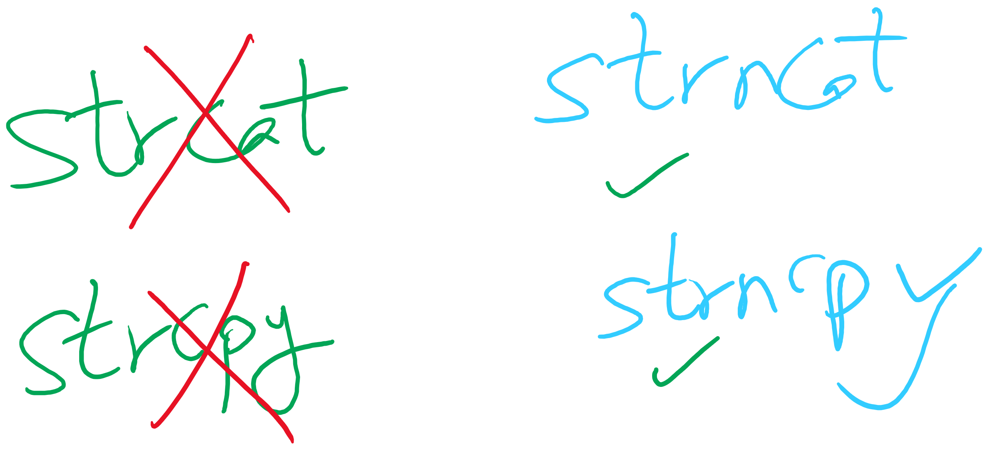
Project 4 Hint

Slide 6
Max Partition Size
Block size | FAT-12 | FAT-16 | FAT-32
0.5 KB | 2 MB
1 KB | 4 MB
2 KB | 8 MB | 128 MB
4 KB | 16 MB | 256 MB | 1 TB
8 KB |  | 512 MB | 2 TB
16 KB |  | 1024 MB | 2 TB
32 KB |  | 2048 MB | 2 TB

Slide 7
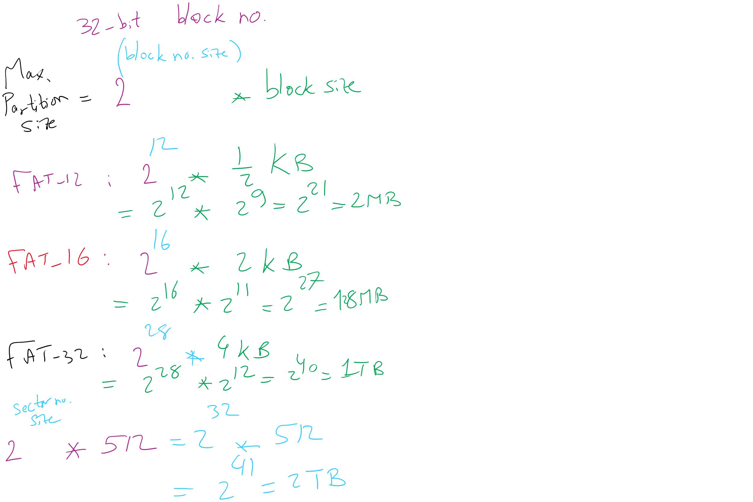
Max Partition Size

Slide 8
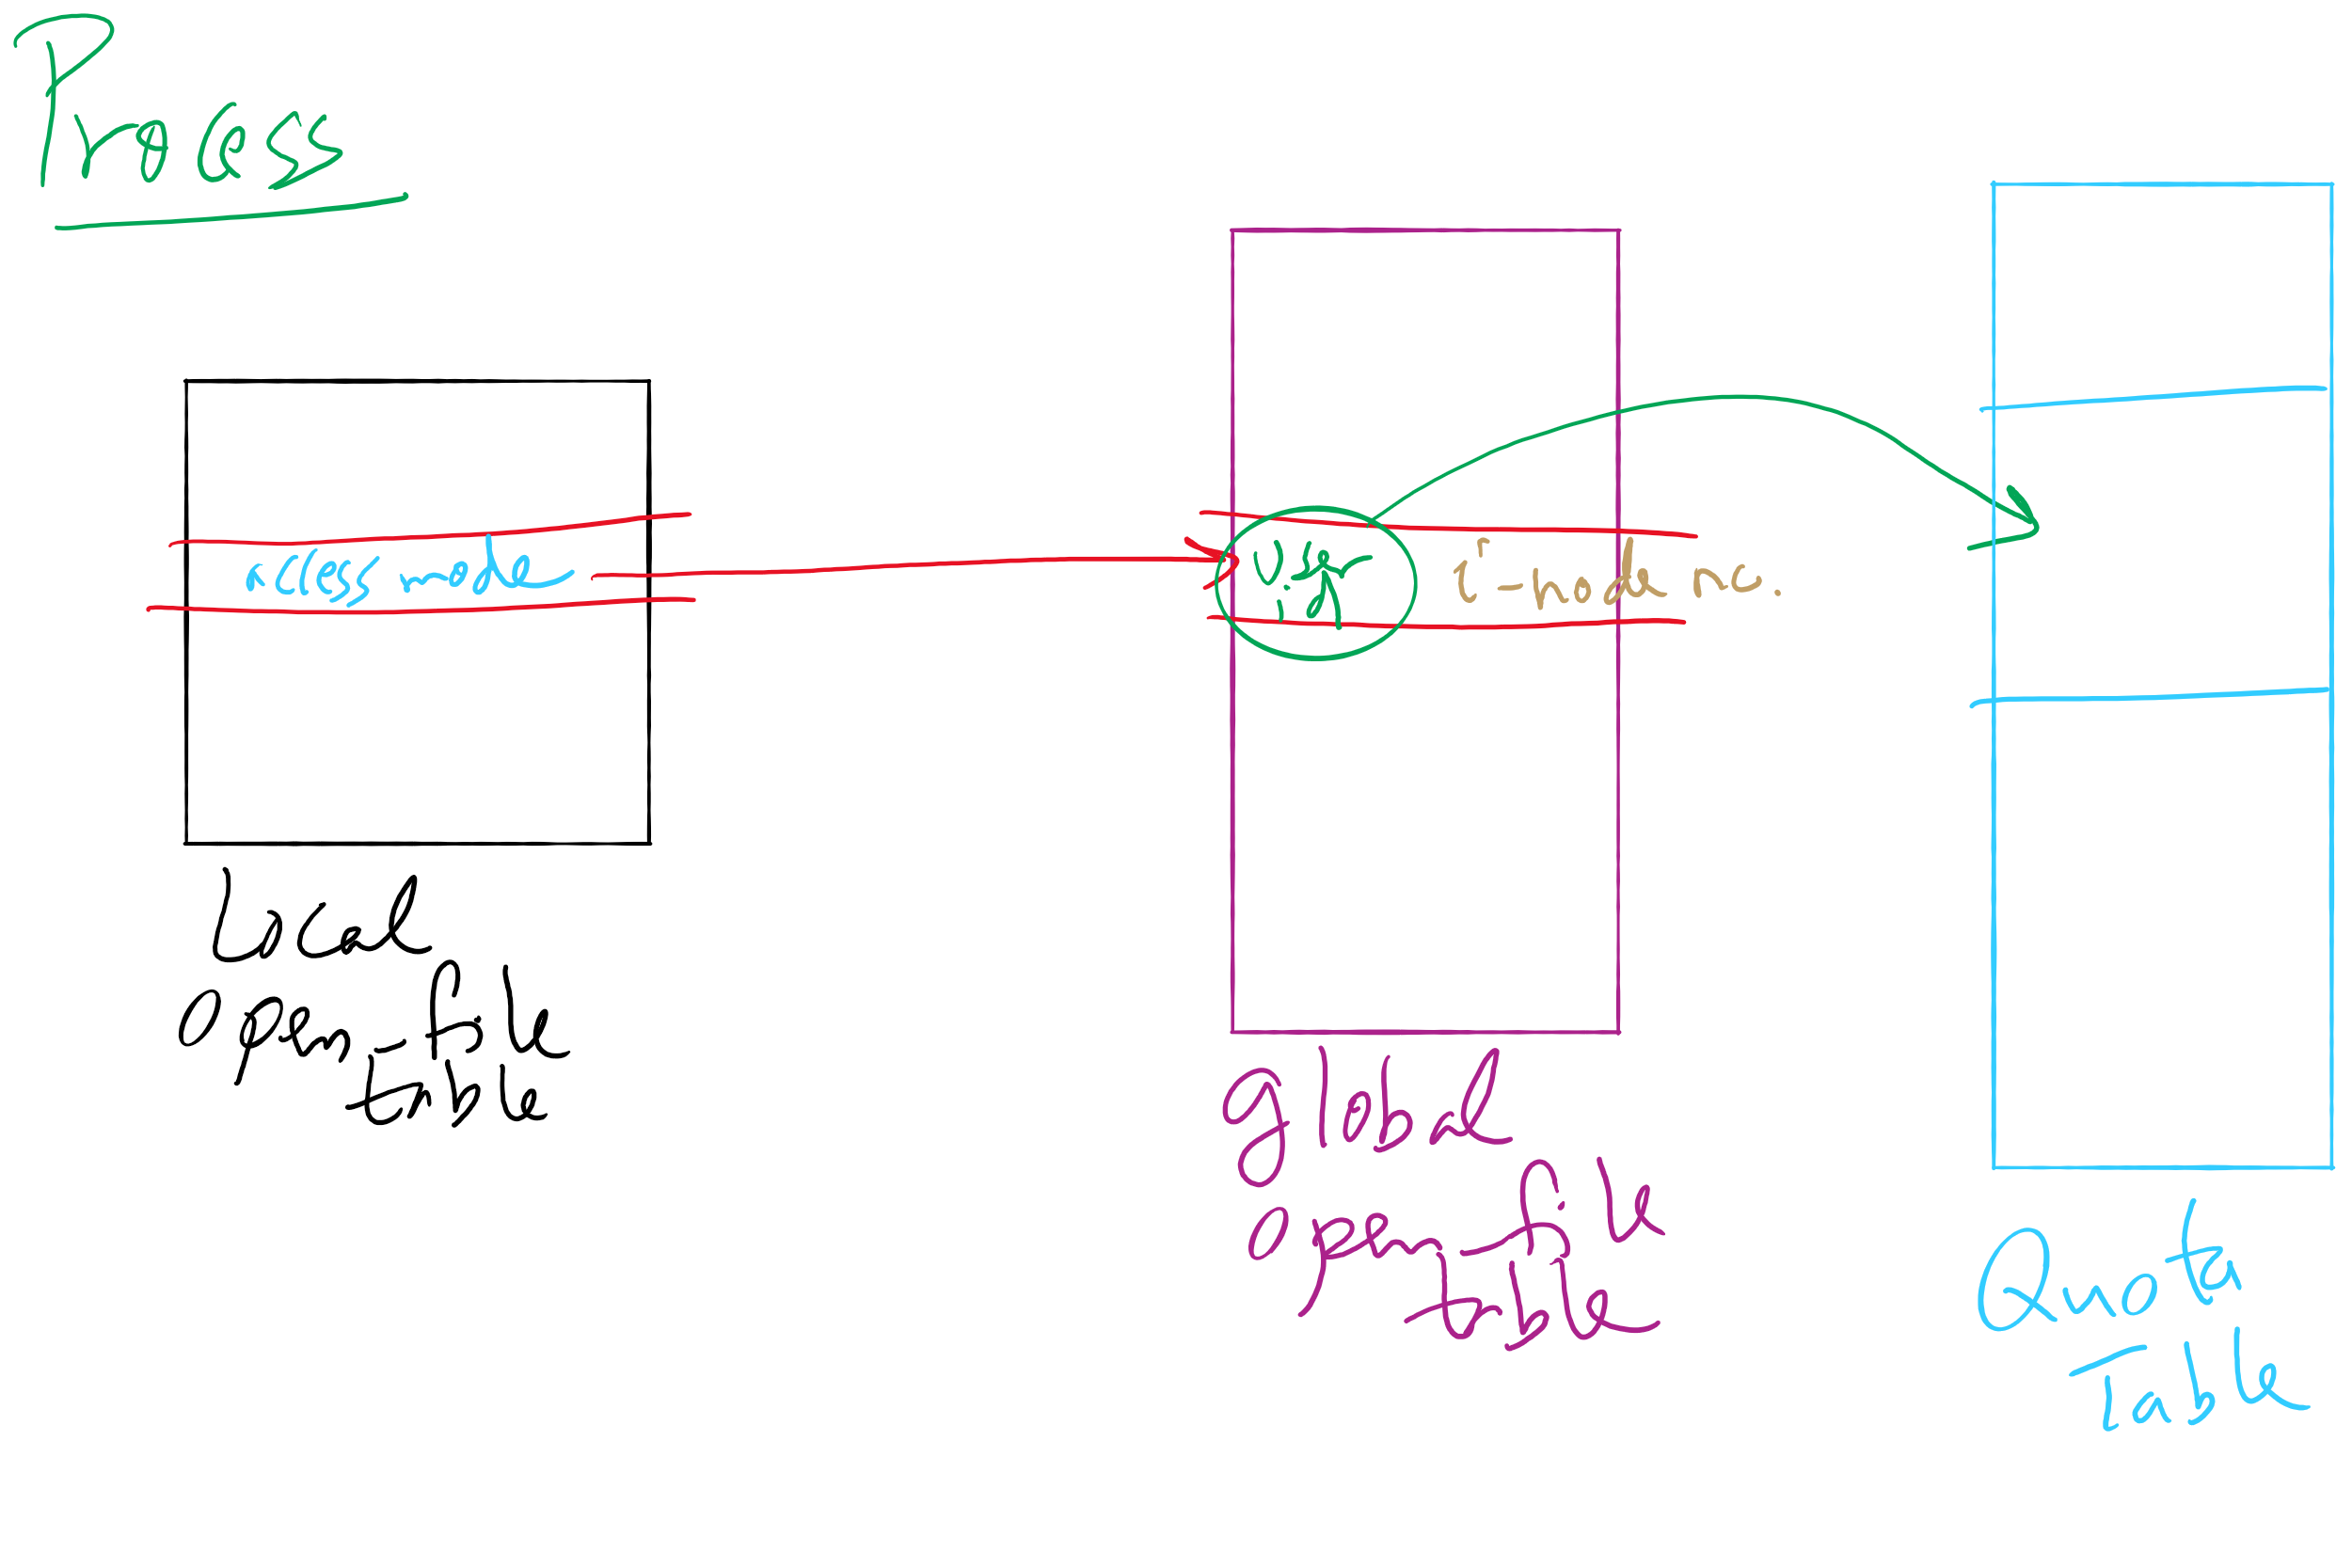
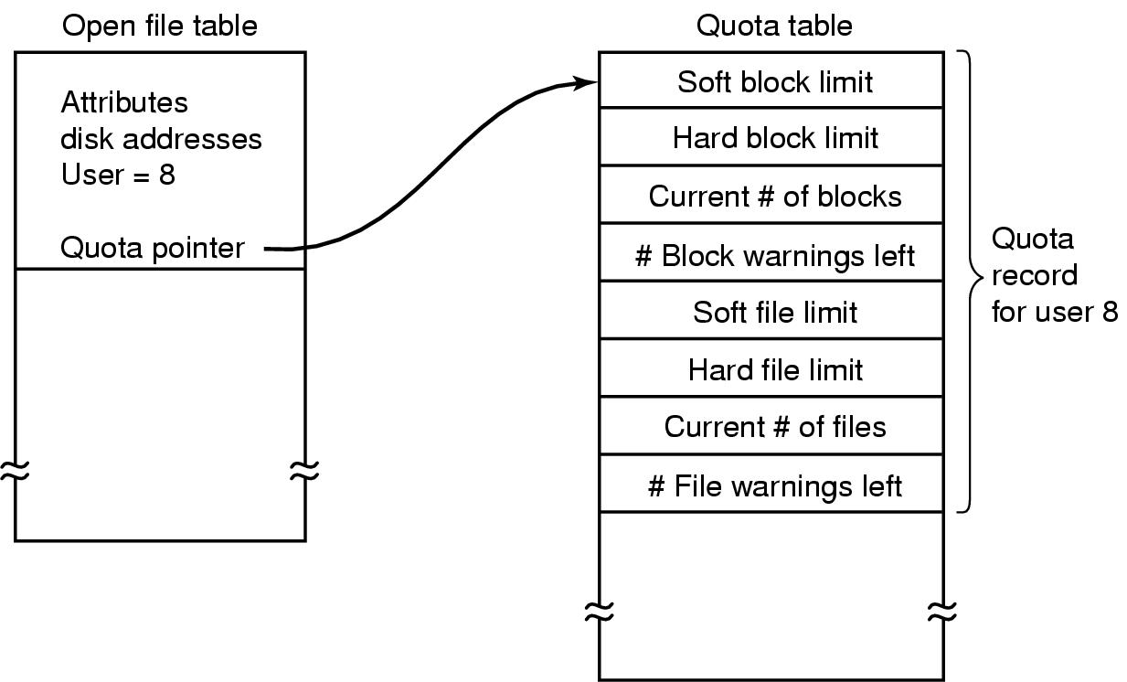
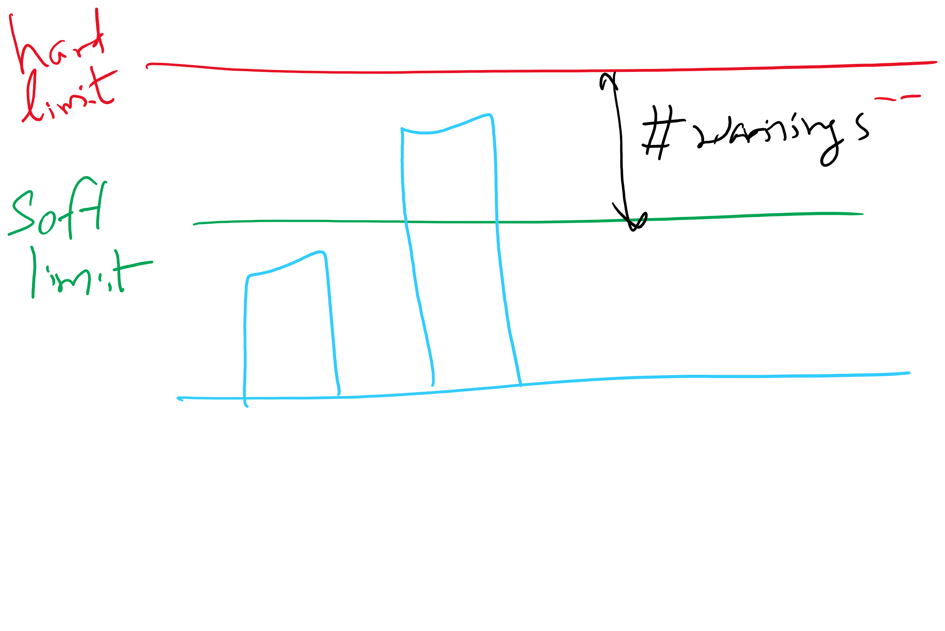
File-related kernel structures: open file tables and disk quotas

Slide 9
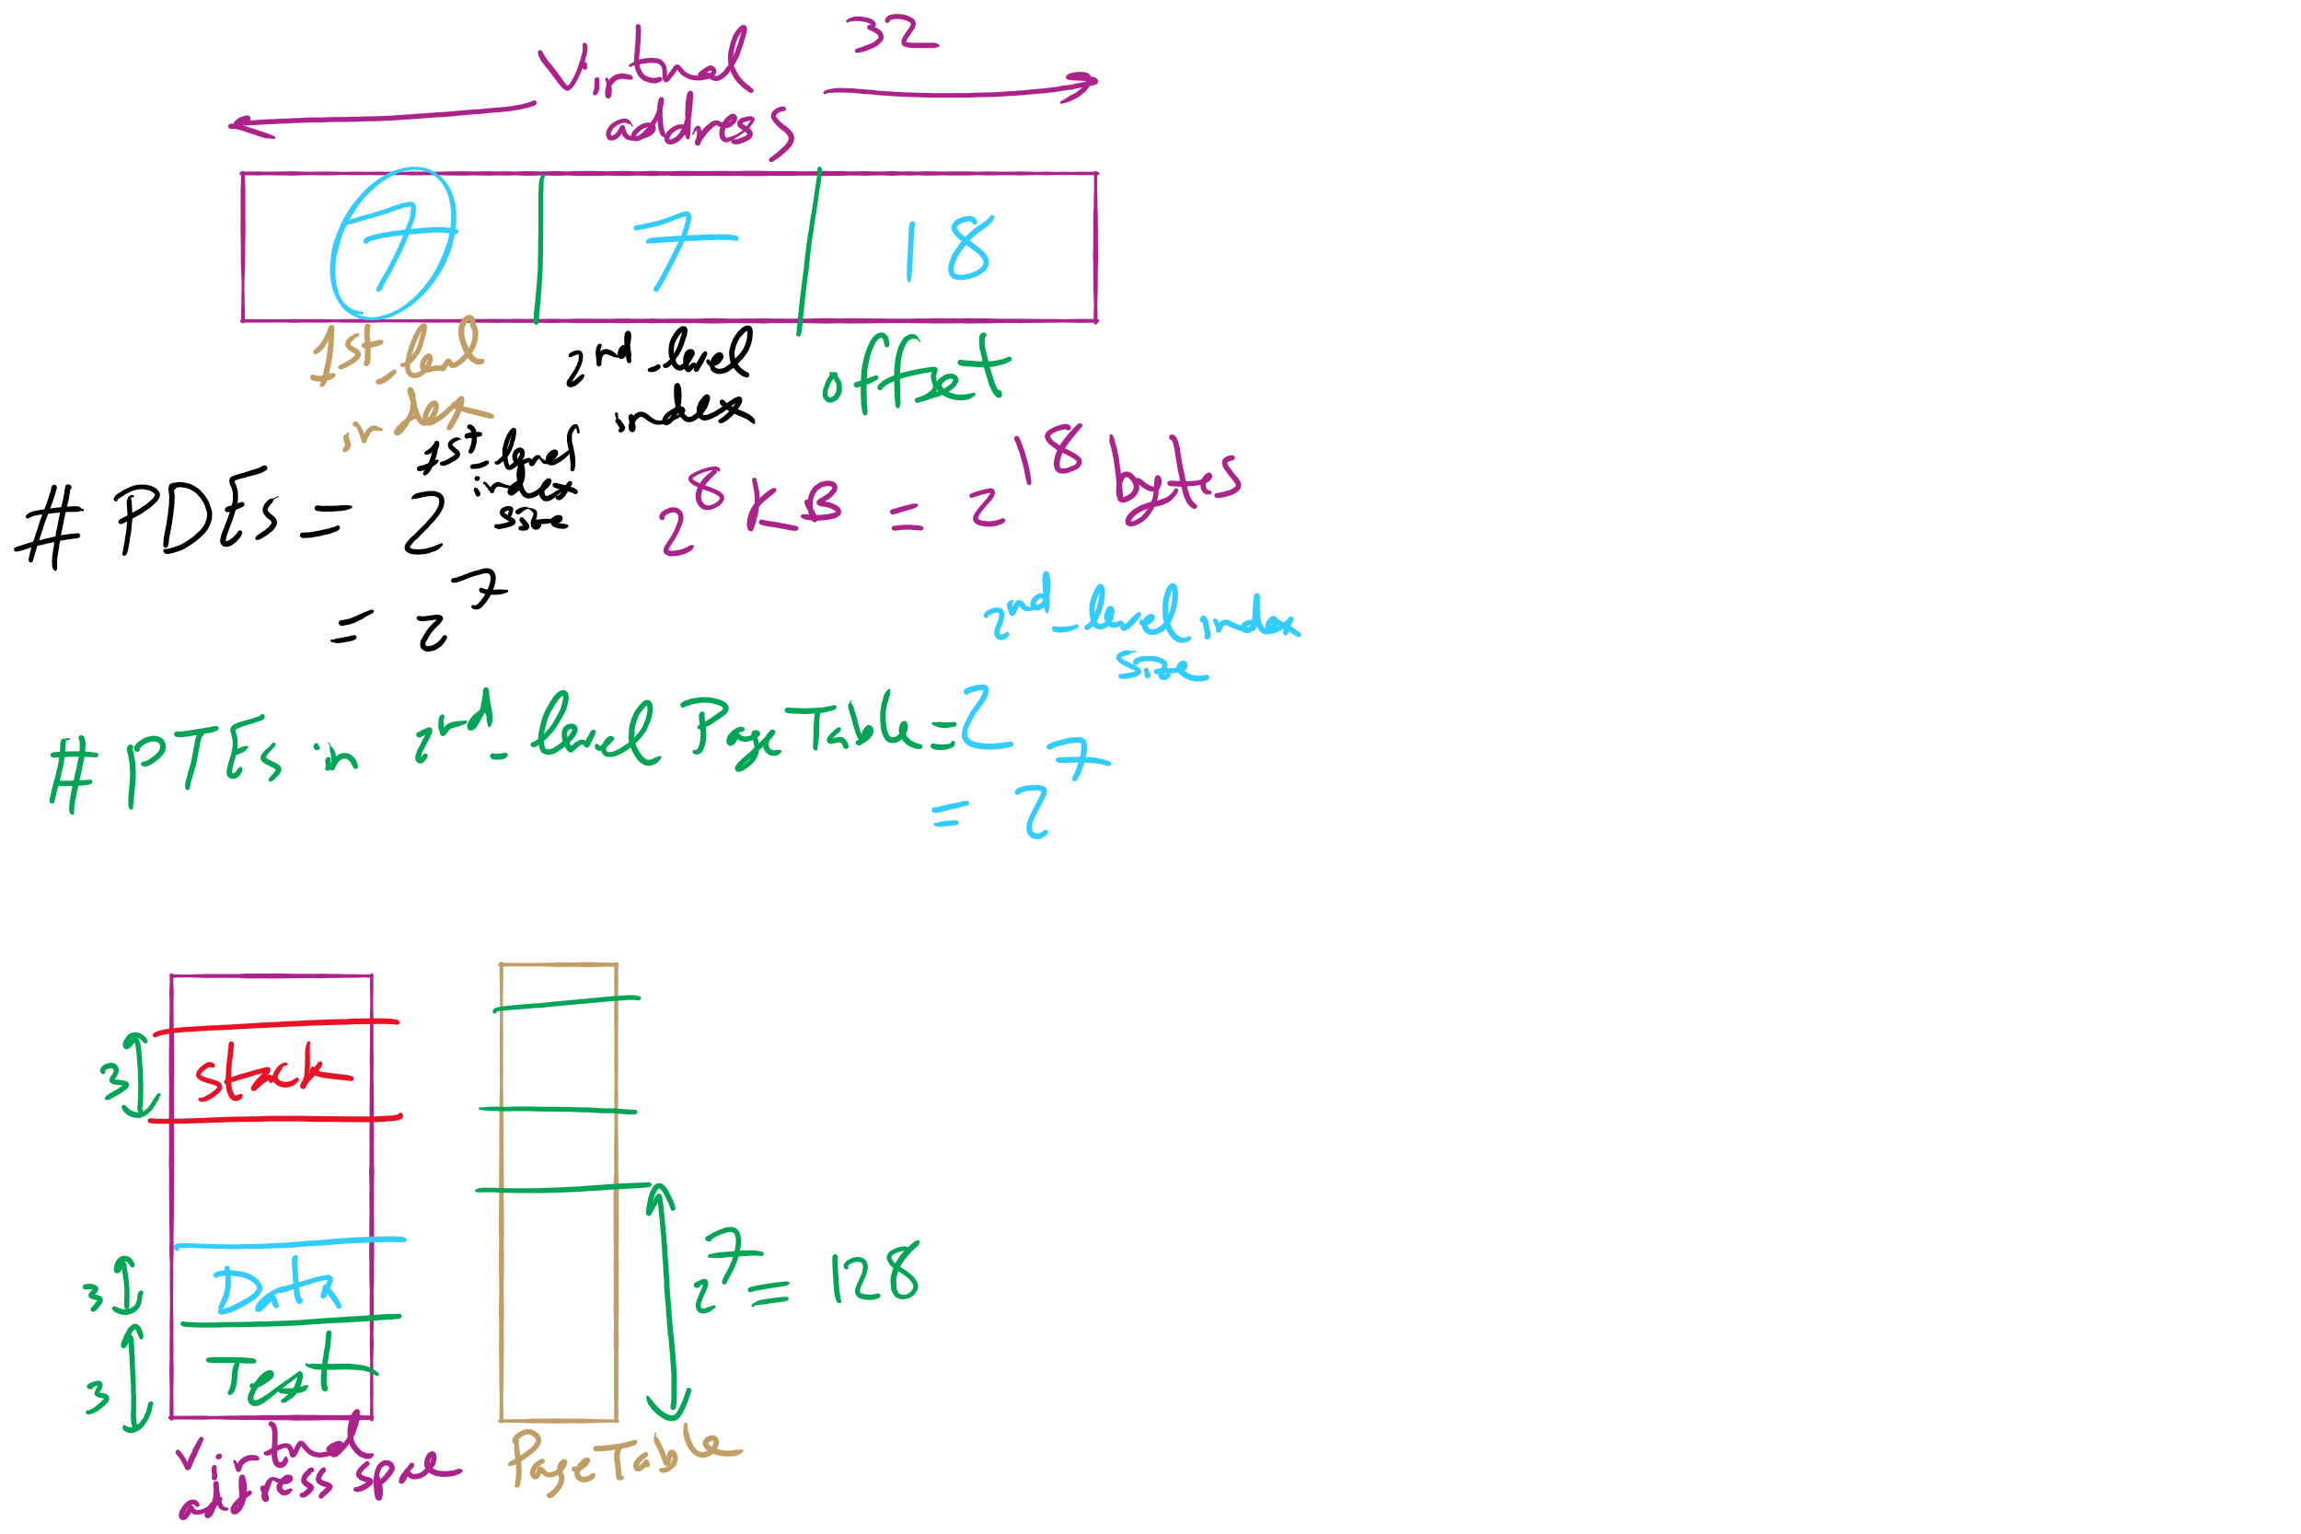
HW 10: Q 2-4

Slide 10
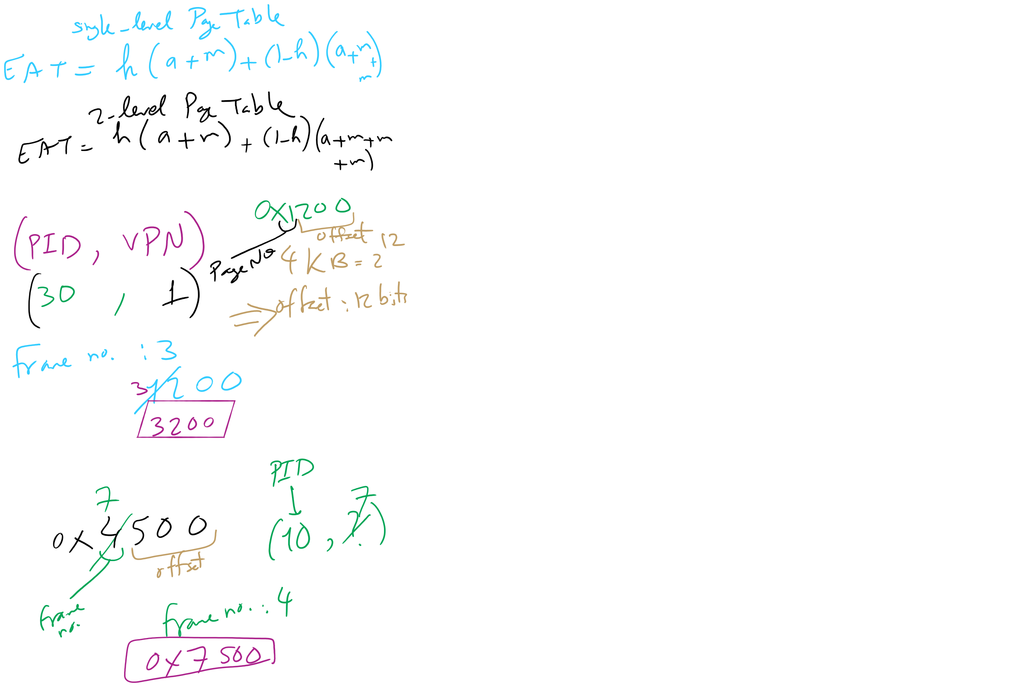
HW 10: Q 10-13

Slide 11
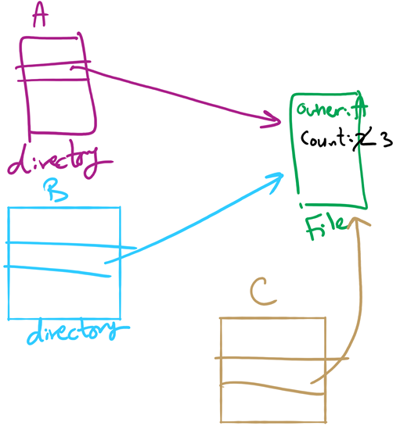
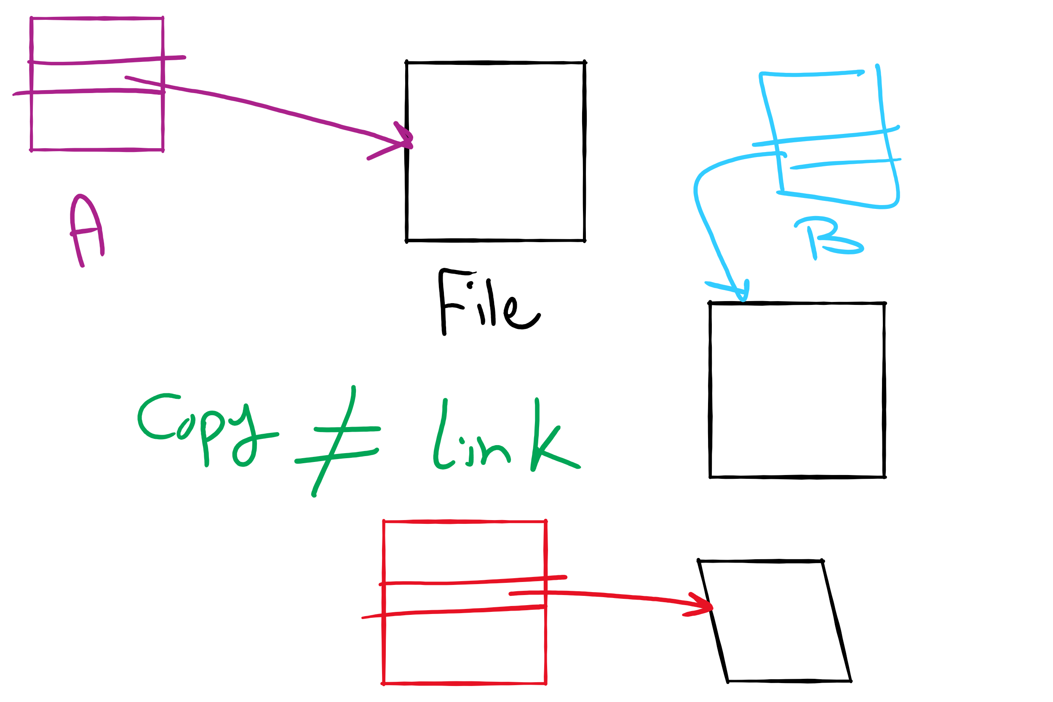
File Linking (left) vs. File Copying (right)

Slide 12
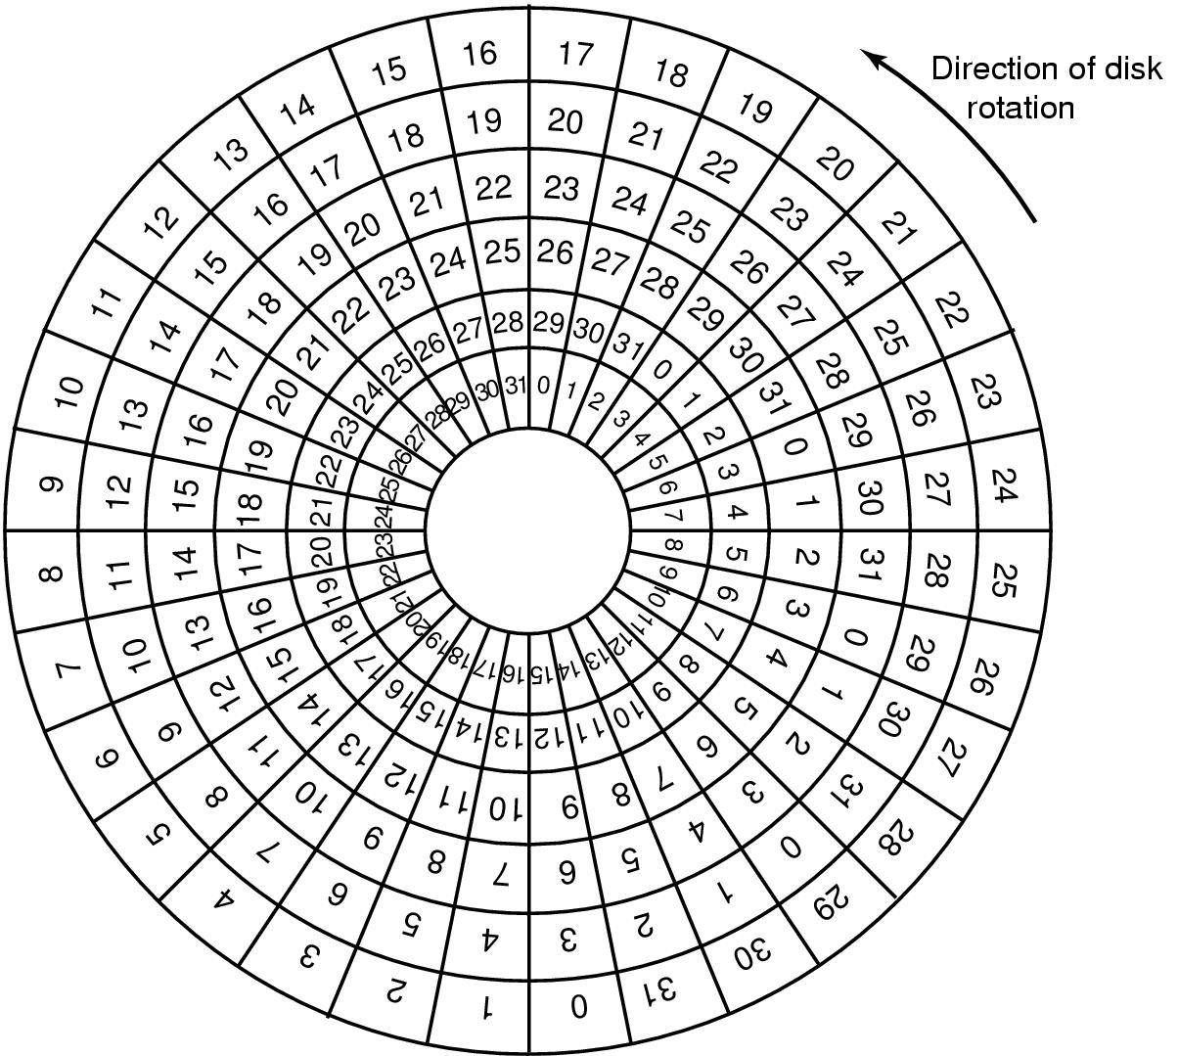
Sector Skew
Sectors numbered sequentially on each track
Numbering starts in different place on each track: sector skew
Allows time for switching head from track to track
All done to minimize delay in sequential transfers

Slide 13
Sector interleaving
On older systems, the CPU was slow => time elapsed between reading consecutive sectors
Solution: leave space between consecutively numbered sectors
This isn’t done much these days…
7
0
7
0
5
0
6
1
3
4
2
3
5
2
6
1
7
6
4
3
2
5
4
1
No interleaving
Skipping 1 sector
Skipping 2 sectors

Slide 14
Flash File System
Wear Leveling
Count total writes per flash sector and attempt to balance across the whole disk

Slide 15
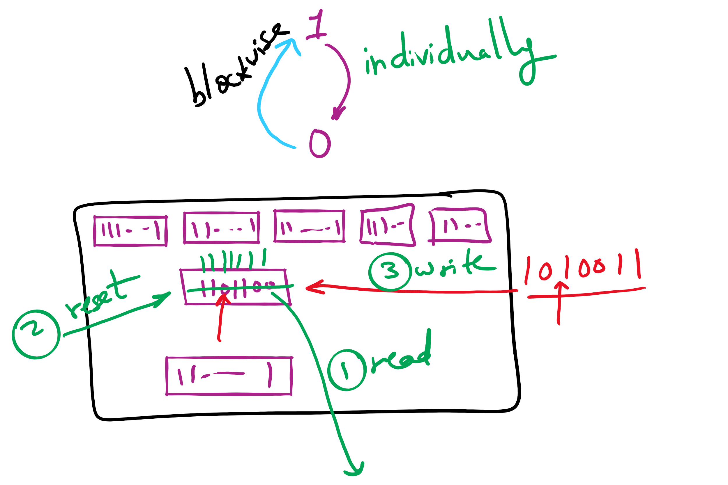
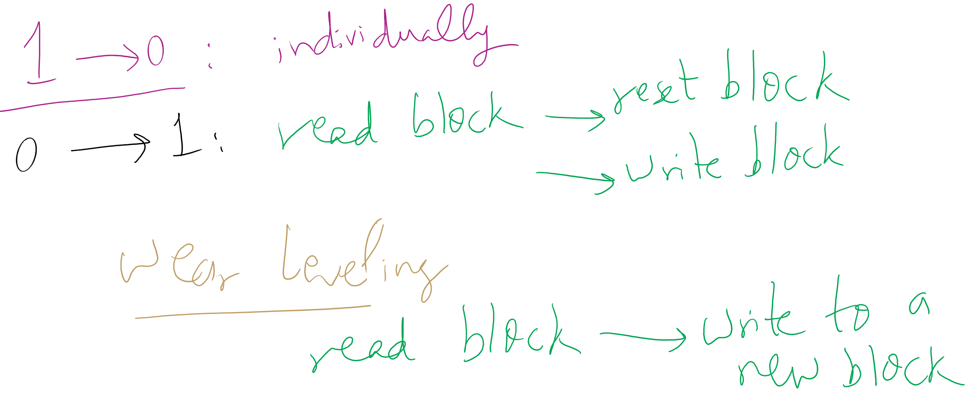
Wear leveling for SSDs

Slide 16
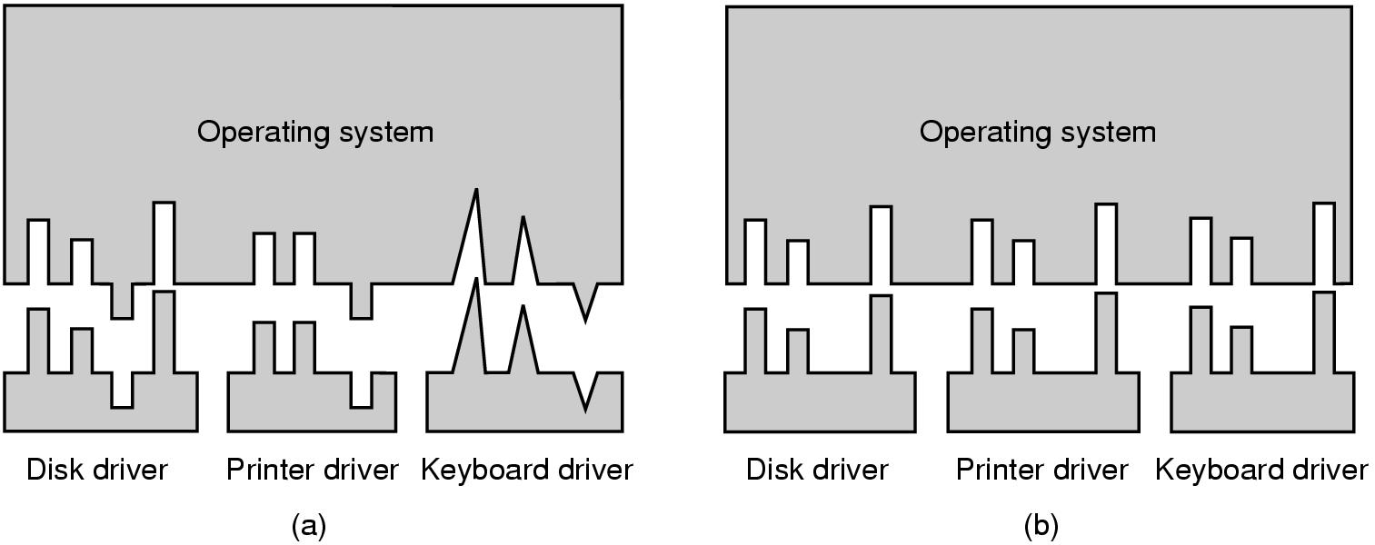
Why a standard driver interface?
Non-standard driver interfaces
Standard driver interfaces

Slide 17
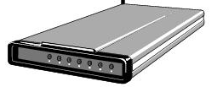
Buffering device input
User space
User space
User space
User space
Kernel space
Kernel space
Kernel space
Kernel space
2
2
1
1
3
Unbuffered input
Buffering in user space
Buffer in kernel Copy to user space
Double buffer in kernel

